Slide 1
Micro-Grid Solution

Slide 2


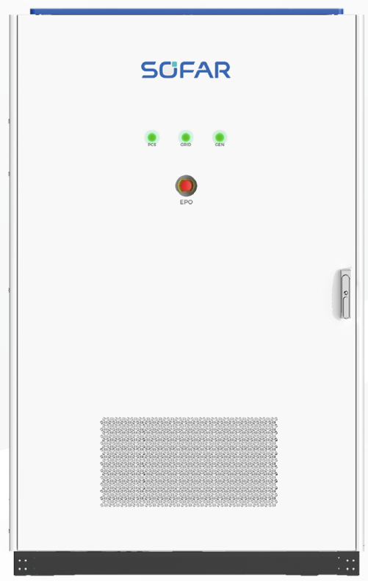
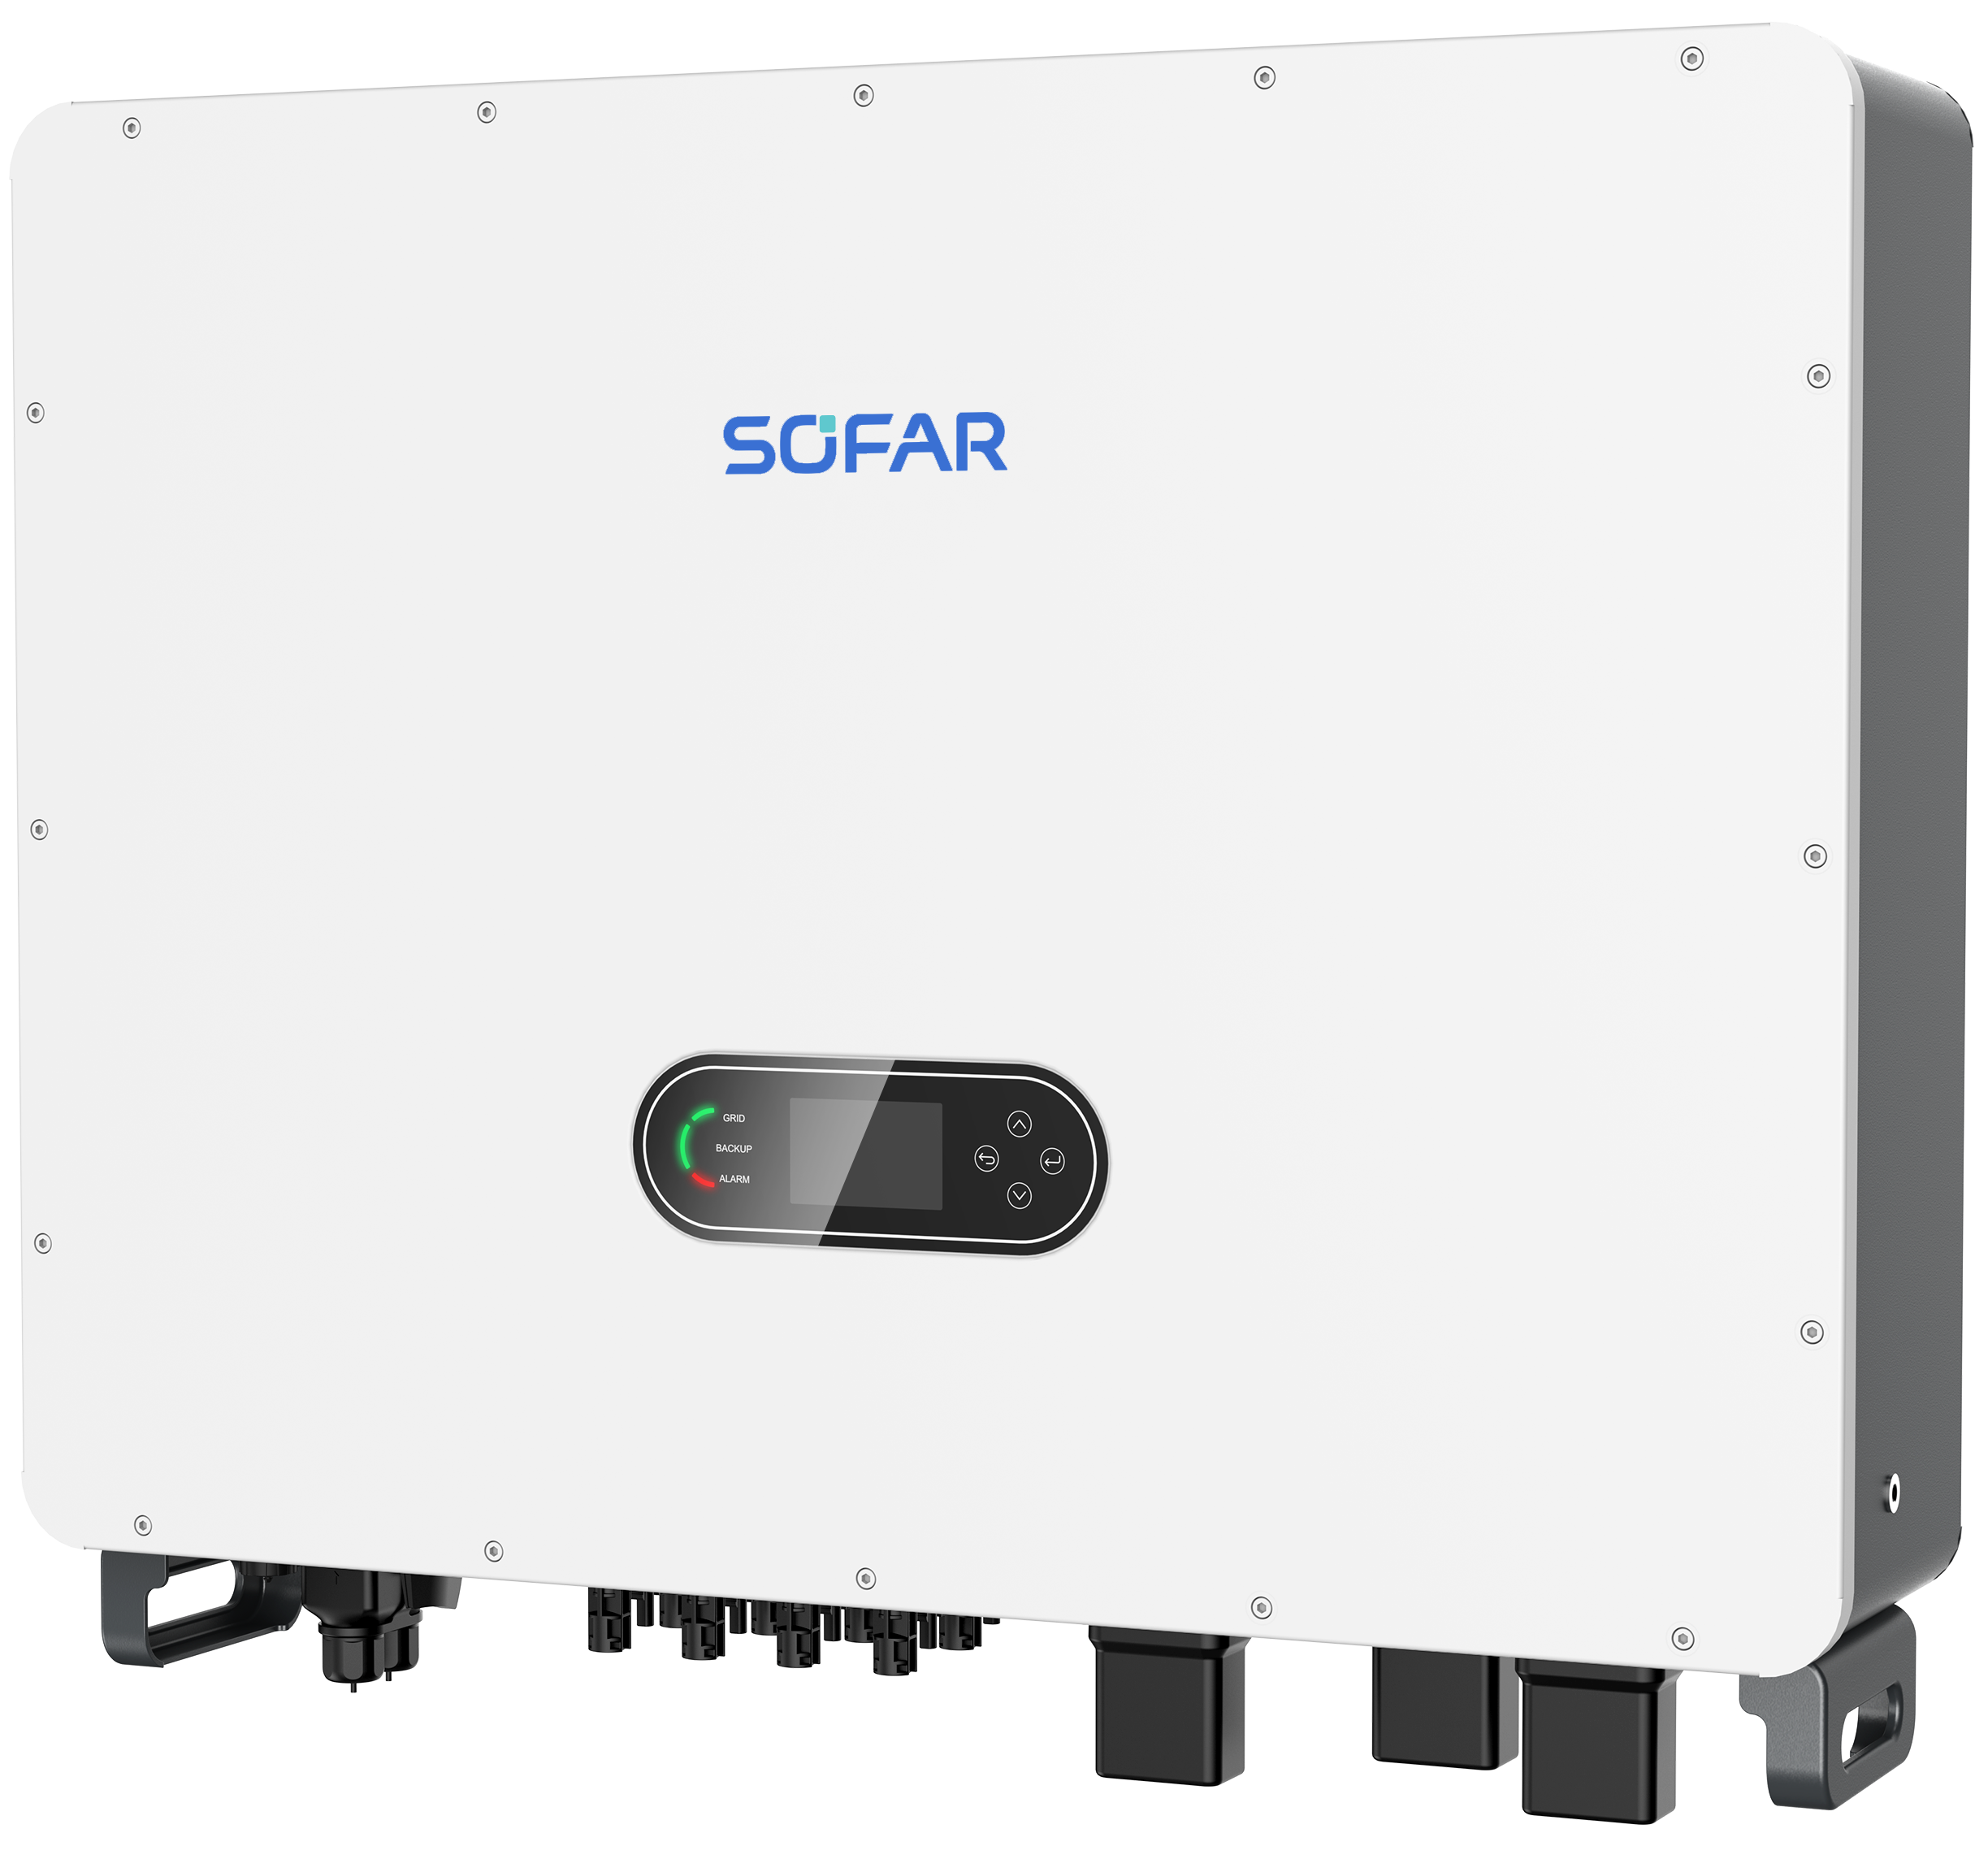





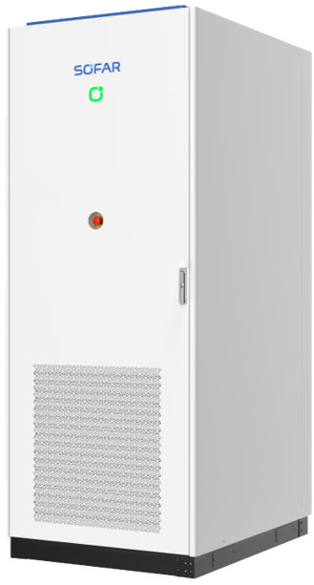
Micro-grid Solution for C&I, adaptable to different scenarios
internet
web/app
Backup Cabinet
…
Grid
PV inverters
power line
communication (RS485/ETH)
…
Diesel Generator
Critical Load
Storage Cabinets

Slide 3

Micro-Grid Solution for C&I
Mode 1 (grid-tide):
In gird-tied mode, the backup cabinet work as the junction cabinet, both the PV and the storage cabinets are controlled together to realize different functionalities, e.g. peak shaving, self-consumption, etc.
Backup Cabinet
Grid
…
STS
…
…
DG
Load
PV inverters
Controller
…
power line
communication (RS485/ETH)
Storage Cabinets

Slide 4
Micro-Grid Solution for C&I
Mode 2 (off-grid):
When the PV power is lager than the load, the PV supplies the load and charges the battery simultaneously.
Backup Cabinet
Grid
STS
…
…
…
DG
Load
PV inverters
Controller
…
power line
communication (RS485/ETH)
Storage Cabinets

Slide 5
Micro-Grid Solution for C&I
Mode 3 (off-grid):
When the PV power is less than the load and the battery has sufficient energy, the PV and the battery supplies the load together.
Backup Cabinet
Grid
STS
…
…
…
DG
Load
PV inverters
Controller
…
power line
communication (RS485/ETH)
Storage Cabinets

Slide 6
Micro-Grid Solution for C&I
Mode 4 (off-grid):
When the PV power is very low and the battery energy is insufficient , the diesel generator needs to work. At this mode, the DG will operate in an efficient woking point to supply the power to the load and charge the battery.
Backup Cabinet
Grid
STS
…
…
…
DG
Load
PV inverters
Controller
…
power line
communication (RS485/ETH)
Storage Cabinets

Slide 7
Storage Cabinet, ESS-261KLC-SA1
Efficient & Flexible
PCS supports both on-grid and off-grid applications
Multiple cabinets can be connected in parallel to support large capacity application
Safety & Friendly
Battery uses liquid cooling and PTC heating, adaptable to various harsh environments
Intrinsic & Active & Passive ultimate safety design
Smart management
Built-in EMS, support diifferent operation modes
Visualisation management, support App and Web multi-end online monitoring

Slide 8
Storage Cabinet, ESS-261KLC-SA1, datasheet
Model | ESS-261KLC-SA1
DC Side
Battery Type | LFP/314Ah
Series and Parallel Mode | 1P260S
Rated Energy | 261kWh
Nominal Voltage | 832V
DC Operating Voltage Range | 650V~949V
Depth of Discharge (DOD) | 98%
AC Side
Type | 3P4W
AC Voltage | 400V AC
Rated AC Power | 125kW
Maximum AC Power | 138kW
Rated Grid Frequency | 50Hz/60Hz
Power Factor | -1~1
Unbalanced Load | 0~100%
System Parameters
Round Trip Efficiency (RTE) | ≥88%@0.5P, ≥90%@0.25P,
Operating Ambient Temperature | -30℃~50℃ (derating above 45℃)
Storage Ambient Temperature | -30℃~60℃
Operating Relative Humidity | 0~100% (No Condensation)
Operating Altitude | ≤4000m
Ingress protection rating | IP55
Anti-Corrosion | C4-M (C5-M Optional)
Cooling Type | Liquid Cooling
Fire Detection | Smoke, Temperature,CO
Fire Suppression | Aerosol/Perfluorohexanone Spray (Optional) Whole Cabinet Level: Water Spray
Explosion Protection | Directional Smoke Extraction & Explosion Venting Panel
Installation | Ground Mounting
Communication | Modbus TCP
Dimension(W*D*H) | 1000mm*1350mm*2500mm
Weight | < 2400kg
Noise | ≤70dB(A)
Standard | IEC62619,IEC62477-1, IEC/EN 61000-6-2/4, UN38.3, UN3480, EN50549-1,

Slide 9
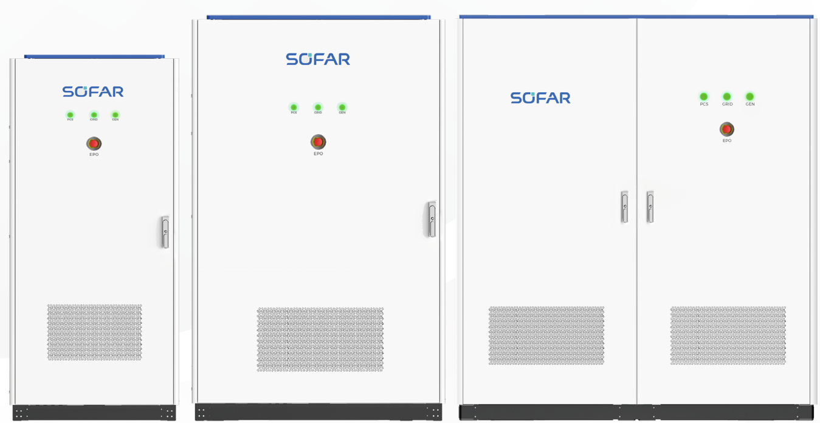
Backup Cabinet, PAC-375K/625K/001M-W2
High yield
Multiple power integration All-inone
Built-in voltage and current detection, grid, generator load, BESS and PVl ports power observable
Grid and load support
Seamless Off-grid switching, noninterrupt of load power
Automatic switching between grid power and generator
Flexible and reliable
Outdoor design, bettter environmental suitability
Built-in bypass switch, better system reliabllity
PAC-375K
PAC-625K
PAC-001M

Slide 10
Backup Cabinet, PAC-375K/625K/001M-W2, datasheet
Model | PAC-375K-W2 | PAC-625K-W2 | PAC-1M0-W2
Grid Side
Rated AC Input/Output Power | 375kVA | 625kVA | 1000kVA
Rated AC Input/Output Current | 543A | 902A | 1449A
Rated AC Input/Output Voltage | 400V, 3P+N | 400V, 3P+N | 400V, 3P+N
Rated Frequency | 50/60Hz | 50/60Hz | 50/60Hz
Load Side
Rated AC Output Power | 375kVA | 625kVA | 1000kVA
Rated AC Output Current | 543A | 902A | 1449A
Rated AC Output Voltage | 400V, 3P+N | 400V, 3P+N | 400V, 3P+N
BESS Side
Max. BESS Ports | 3 | 5 | 8
Rated AC Voltage | 400V, 3P+N | 400V, 3P+N | 400V, 3P+N
Max. AC Power per Port | 138kW/kVA | 138kW/kVA | 138kW/kVA
Max. AC Current per Port | 198A | 198A | 198A
PVI Side
Max. PVI Ports | 3 | 5 | 8
Rated AC Voltage | 400V, 3P | 400V, 3P | 400V, 3P
Max. AC Power per Port | 138kW/kVA | 138kW/kVA | 138kW/kVA
Max. AC Current per Port | 198A | 198A | 198A
GEN Side
Rated AC Input Power | 375kVA | 625kVA | 1000kVA
Rated AC Input Current | 543A | 902A | 1449A
Rated AC Input Voltage | 400V, 3P+N | 400V, 3P+N | 400V, 3P+N
System Characteristics
Off-grid switching time | <15 ms | <15 ms | <15 ms
Operating Temperature | -35℃~60℃，＞50℃ derating | -35℃~60℃，＞50℃ derating | -35℃~60℃，＞50℃ derating
Max. Working Altitude | 2000m，＞2000m optional | 2000m，＞2000m optional | 2000m，＞2000m optional
Cooling Method | Smart controlled air cooling | Smart controlled air cooling | Smart controlled air cooling
Communication Ports | CAN,RS485,Ethernet,Dry contactors | CAN,RS485,Ethernet,Dry contactors | CAN,RS485,Ethernet,Dry contactors
Ingress Protection | IP55 | IP55 | IP55
Product Standard | IEC/EN 61439-1/-2 | IEC/EN 61439-1/-2 | IEC/EN 61439-1/-2
Mechanical Parameters
Dimensions (W*H*D) | 700*1800*800 mm | 1200*2100*1000 mm | 1600*2100*1000 mm
Weight | 400kg | 650kg | 800kg
Installation | Floor mount | Floor mount | Floor mount
PAC-375K
PAC-625K
PAC-001M

Slide 11



Website
www.sofarsolar.com
Email
info@sofarsolar.com
Address
11th Floor, Gaoxinqi Technology Building,
District 67, Xingdong Community, Xin'an
Street, Bao'an District, Shenzhen, China

